Slide 1
Performance comparison of CatGAN using different FER datasets
Junyeob Kim

Slide 2
Introduction
Depending on the probability distribution of dataset, the performance of deep learning model changes.
FER datasets are chosen because there are various datasets available
We show the different probability distribution of each FER dataset.
Use CatGAN to prove the change in performance.

Slide 3
T-SNE^{[1]}
A method to perform dimensionality reduction
Minimizes divergence between two distributions
Distribution that measures pairwise similarities of input objects
Similar distribution in low dimensional points
T-SNE preserves local similarities, and therefore is better at visualizing high dimensional data.
1. L. Maaten, G. Hinton. Visualizing Data using t-SNE. J. Mach. Learn. Res, 2008, 9, 2579-2605.

Slide 4
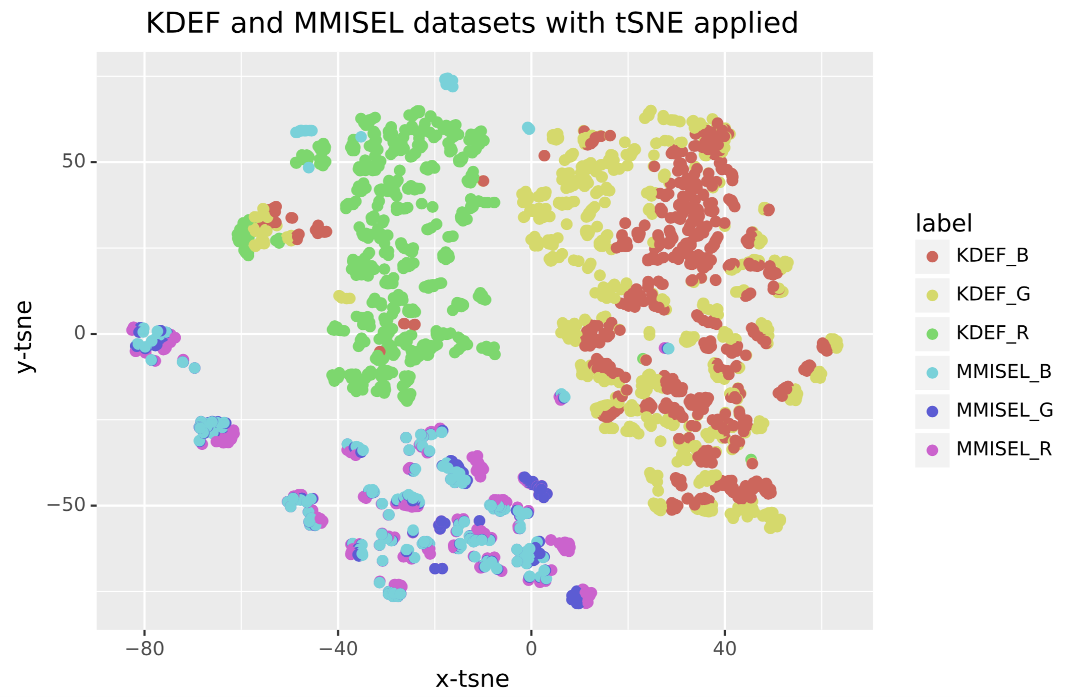
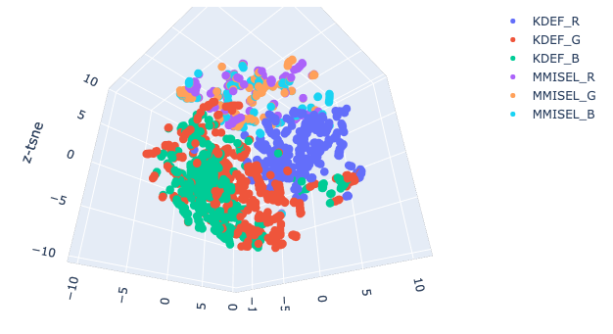
Results
It is possible to observe that distributions of KDEF and MMI selected datasets are different

Slide 5
Visualizing with MoG
Assumption – an image can be represented by Mixture of Gaussian distributions of three channels; Red, Blue and Green
Since distributions of each dataset are different, gaussian mixture models will be different as well.

Slide 6
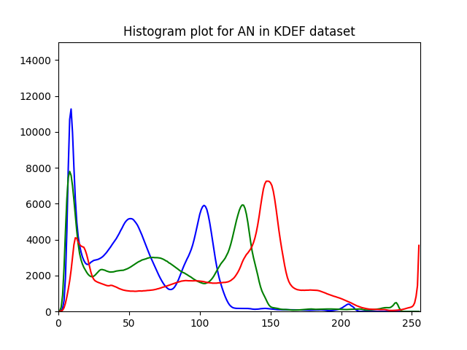
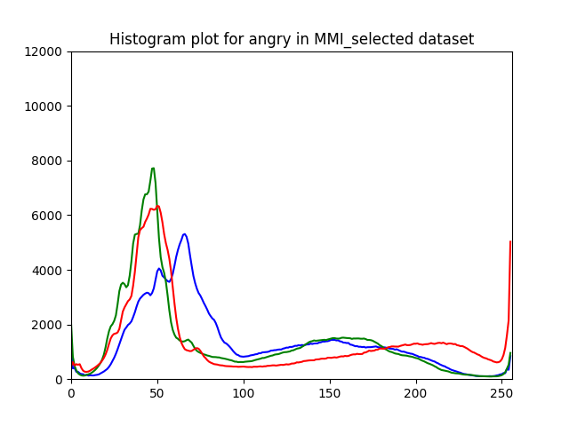
Results
It is possible to observe that each distributions contain different combinations of Gaussian distributions

Slide 7
GAN^{[1]}
Generative Adversarial Network – a network to perform unsupervised training.
Update Models
Uniform Distribution
Generator
Fake Data
Discriminator
Losses
Inverse Transform Sampling
Real Data
I. J. Goodfellow, J. Pouget-Abadie, M. Mirza, B. Xu, D. Warde-Farley, S. Ozair, A. Courville, Y. Bengio.
Generative Adversarial Nets. Adv Neural Inf Process Syst, 2014, 27.

Slide 8
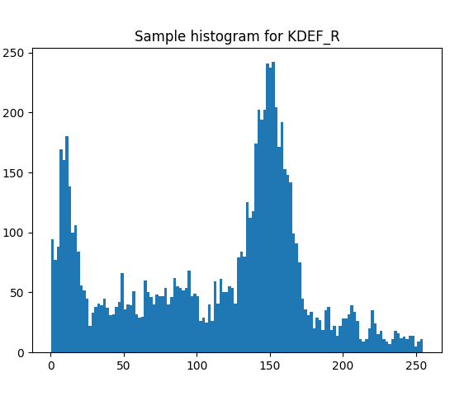
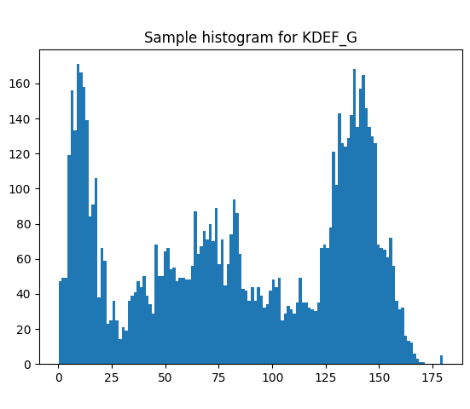
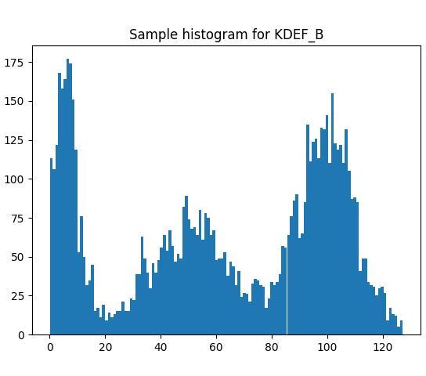
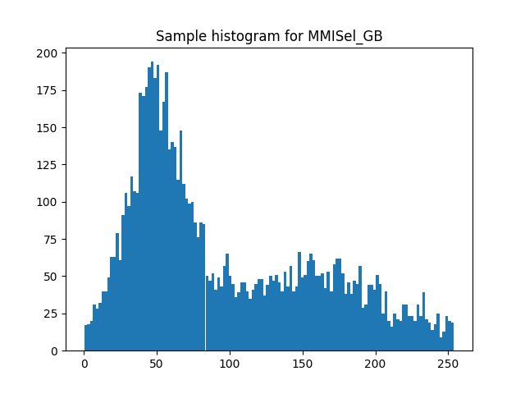
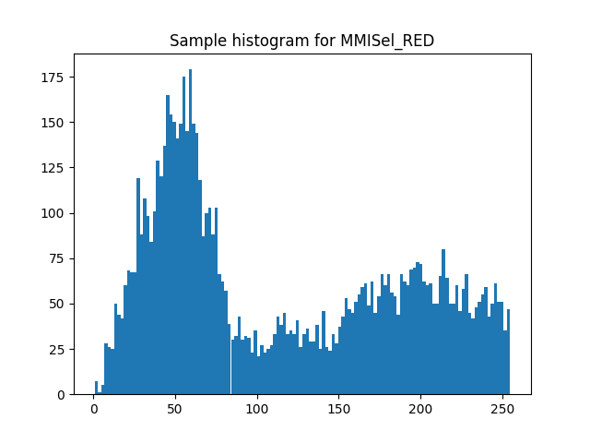
Inverse Transform Sampling
Used to generate samples of RGB distribution, which are remodeled using mixture of gaussians.

Slide 9

Test Plans
For each data shown in histograms
Produce arrays with size $28×28$ and put data into the array.
Run DCGAN^{[1]} using this modified dataset.
Get sum of mean squared errors between ‘real data’ and ‘fake data’ using the trained generator.
Used Adam as optimizer
A. Radford, L. Metz, S. Chintala. Unsupervised Representation Learning with Deep Convolutional Generative Adversarial Networks. ICLR 2016.

Slide 10
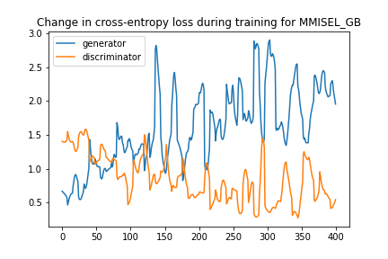
Results
Distribution | Mean Squared Error
KDEF_R | 0.5078
KDEF_G | 0.3764
KDEF_B | 0.2198
MMISEL_R | 0.6216
MMISEL_GB | 0.5198
Table showing MSE of GANs from test,
with each distribution as input
Cross entropy loss of two models during training.
Similar results obtained for all distributions
Error varies hugely depending on the distribution
However, error differed hugely when the model was restarted
Possibly due to the shape of the input – 2D array
As the input is random sample from the original distribution (MoG), there will be no locational features that CNN needs to extract, in order to generate good samples.

Slide 11
1D GAN
In order to check whether using original sample as input data, a new network is created
1D GAN with 1D Convolution
Same loss and optimization function as DCGAN

Slide 12
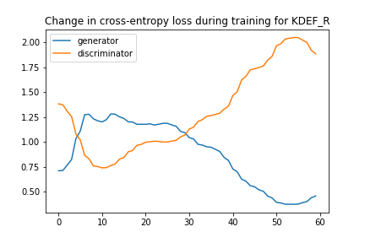
Results
Distribution | Mean Squared Error
KDEF_R | 0.2711
KDEF_G | 0.2106
KDEF_B | 0.1460
MMISEL_R | 0.3783
MMISEL_GB | 0.3102
Table showing MSE of GANs from test,
with each distribution as input
Cross entropy loss of two models during training.
Similar results obtained for all distributions
Significantly lower error compared to DCGAN results

Slide 13
CatGAN^{[1]}
A variation of GAN which enables semi– supervised learning.
Before using the Mixture of Gaussian distribution as input, MMI selected and KDEF datasets, without modifications, are used.
In order to investigate the performance of the network, three different optimizers activation functions are used.
Optimizers: Adam, RMSProp, SGDM
Activation functions: Relu, Leaky Relu, Clipped Relu
J. T. Springenberg . Unsupervised and Semi-Supervised Learning with Categorical Generative Adversarial Networks. ICLR 2016.

Slide 14
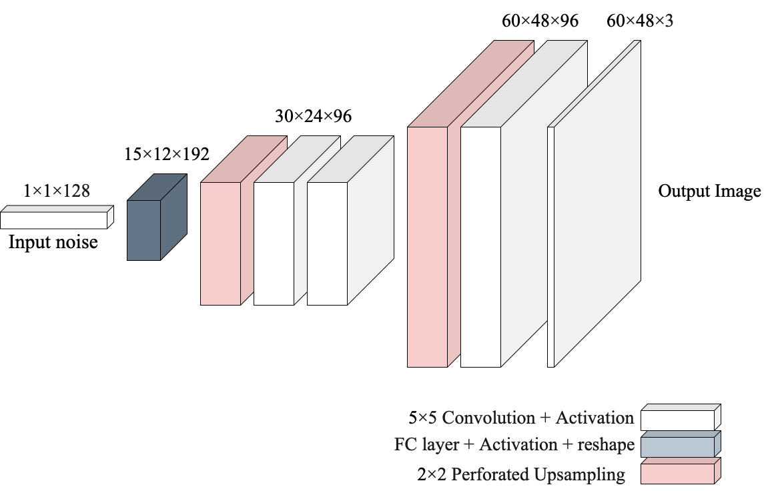
Model summary - Generator

Slide 15
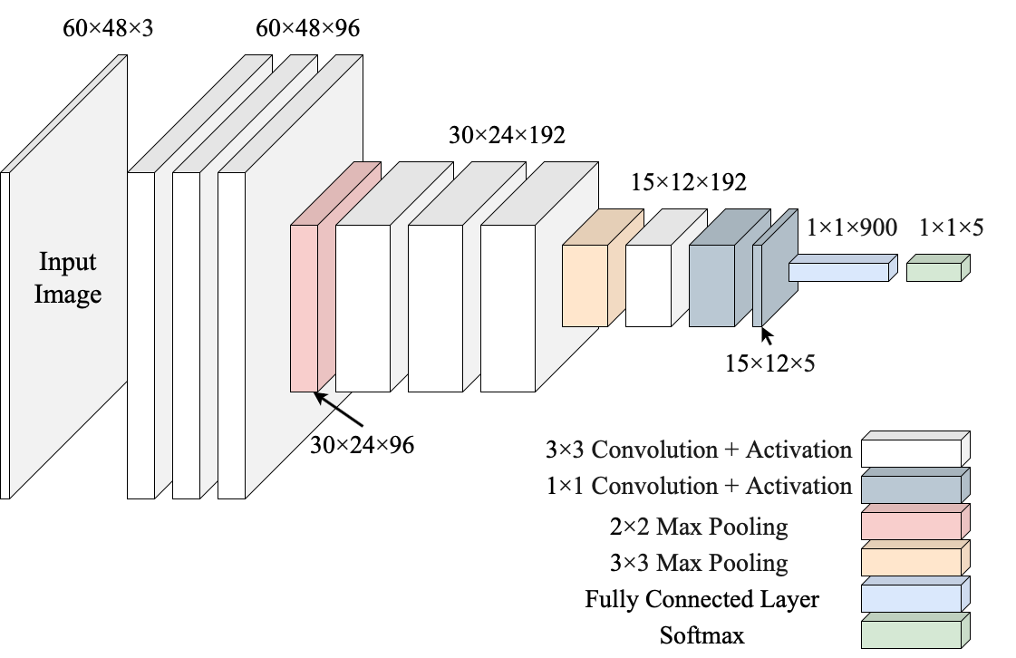
Model summary - Discriminator

Slide 16
Results
KDEF
839 images |  |  | Train = 588 |  |  | Test = 251 |  | Learning rate = 1e-4
 | Adam |  |  |  | RMSProp |  |  | SGDM
 | Relu | ClippedRelu | LeakyRelu | LeakyRelu | Relu | ClippedRelu | LeakyRelu | Relu | ClippedRelu | LeakyRelu
Accuracy | 0.8125 | 1 | 0.9875 | 0.9875 | 0.75 | 1 | 0.8125 | 0.325 | 1 | 0.3375
MMI selected
267 images |  |  | Train = 187 | Train = 187 |  | Test = 80 |  | Learning rate = 1e-4
 | Adam |  |  |  | RMSProp |  |  | SGDM
 | Relu | ClippedRelu |  | LeakyRelu | Relu | ClippedRelu | LeakyRelu | Relu | ClippedRelu | LeakyRelu
Accuracy | 1 | 1 |  | 1 | 0.9721 | 1 | 0.9880 | 0.753 | 1 | 0.9323
With current discriminator network, Clipped Relu resulted with the best performance.

